Slide 1
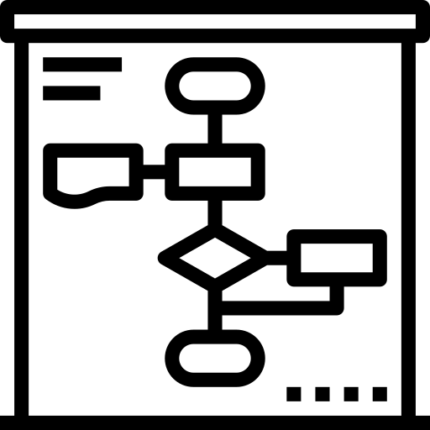
HCL Automation Power Suite Architecture
DYNAMIC WORKLOAD CONSOLE
Custom applications and clients
ASSISTANTS
VIEW AND OPERATE
Dashboard
Modeling
What-If
Security & configuration
HCL Clara
HCL HERO
Graphical views
Monitoring
Reporting
Self-service
Etherogeneous
ENGINE
Deployment options all compatible
for end-to-end configurations
Planning
REST APIs
HA/DR
ENGINE AUTOMATE WITH HA
Dynamic Scheduling
Event Management
Distributed
Mainframe
Predictive analysis
DevOps
Single tenancy SaaS with HCL Now
DB/2 – Oracle – Informix - MS/SQL - VSAM
Automation Hub
AGENTS
AGENTLESS
Datacenter Automation
File Transfer
EXECUTE
Cloud Automation
ERP Process Automation
AIX - HP - IBMi – Linux – Solaris – Windows – z/OS -
Product license includes all features
Containers Management
DB & BigData
management
Notes:
https://www.ibm.com/marketplace/purchase/configuration/en/us/checkout?editionID=EID8ITI6

